Slide 1

Statistical and machine learning models for resolving metabolomics spectra
Dr Vinny Davies, University of Glasgow

Slide 2

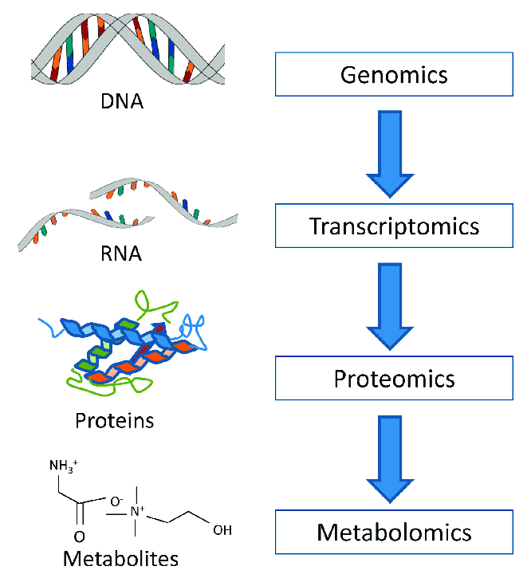
What is Metabolomics?
Metabolomics is the "systematic study of the unique chemical fingerprints that specific cellular processes leave behind", the study of their small-molecule metabolite profiles.
Basically, we are trying to identify all the metabolites in a particular sample

Slide 3
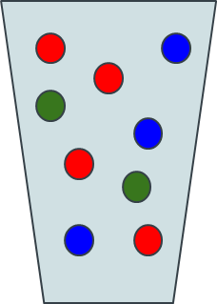
Metabolomics Workflow
Sample + Sample Preparation

Slide 4
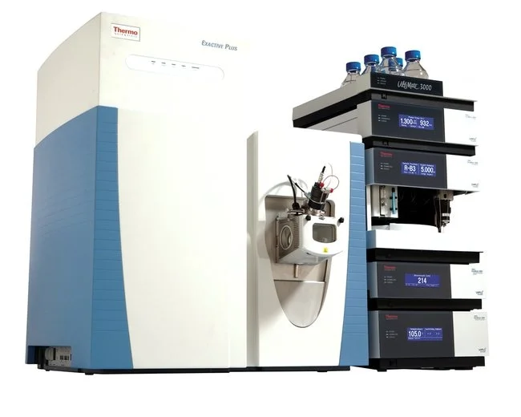
Metabolomics Workflow
Sample + Sample Preparation
Data Collection

Slide 5
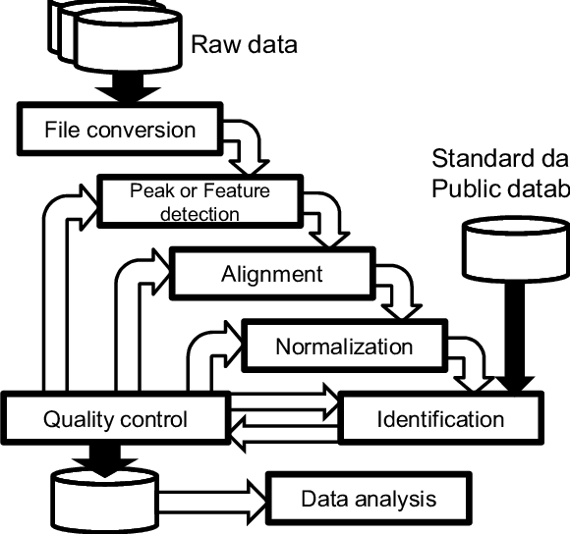
Metabolomics Workflow
Sample + Sample Preparation
Data Collection
Data Processing

Slide 6
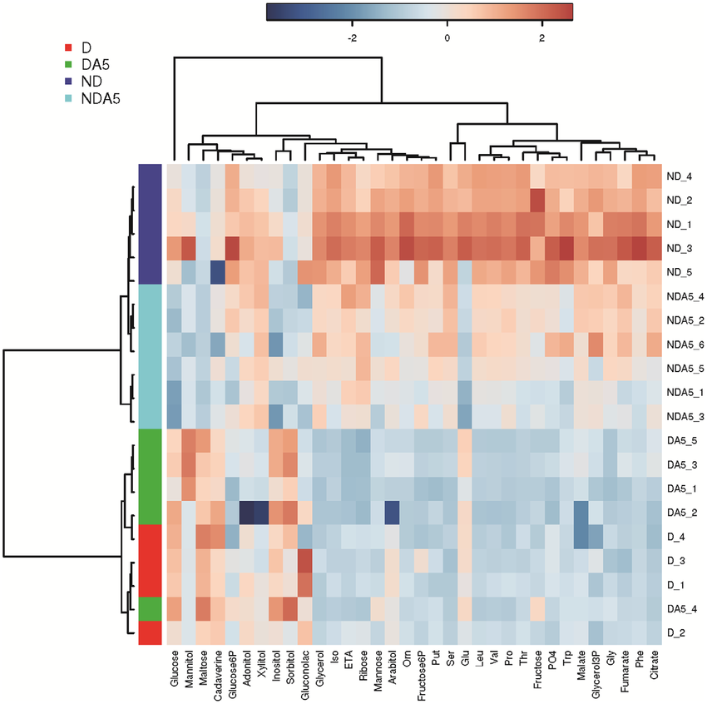
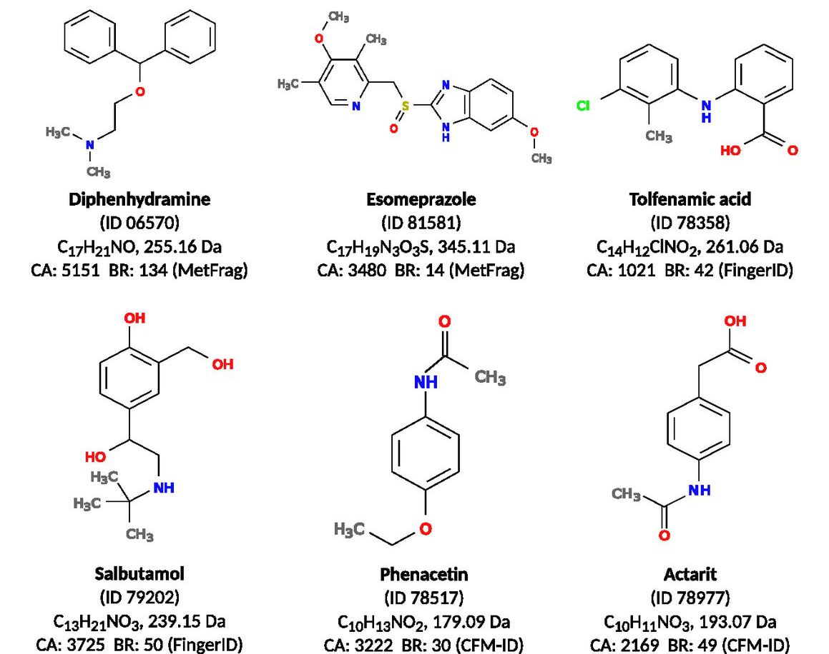
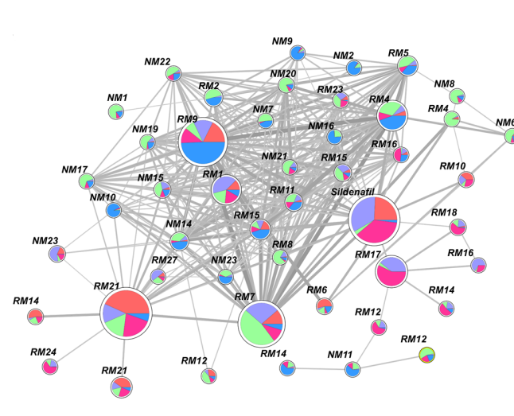
Statistical Analysis
Metabolomics Workflow
Sample + Sample Preparation
Data Collection
Data Processing
Metabolite Identification
Molecular Networking

Slide 7
Metabolomics Mass Spectrometry Experiments
Samples can be extremely varied, but standard option is blood, urine, etc – We use beer!
No data protection issues
Cheap and easily available
Similar enough for method development

Slide 8
Metabolomics Mass Spectrometry Experiments
Samples can be extremely varied, but standard option is blood, urine, etc – We use beer!
No data protection issues
Cheap and easily available
Similar enough for method development
Ionisation

Slide 9
Metabolomics Mass Spectrometry Experiments
Samples can be extremely varied, but standard option is blood, urine, etc – We use beer!
No data protection issues
Cheap and easily available
Similar enough for method development
Mass Spectrometer
Ionisation

Slide 10
Metabolomics Mass Spectrometry Experiments
Samples can be extremely varied, but standard option is blood, urine, etc – We use beer!
No data protection issues
Cheap and easily available
Similar enough for method development
Mass Spectrometer
Intensity
Ionisation
m/z

Slide 11
LC-MS/MS
MS
scans
Sample
Sample fraction, collected in small time period
Mass (per charge)
Chromatographic peaks
intensity
Chromatographic retention time
retention time

Slide 12



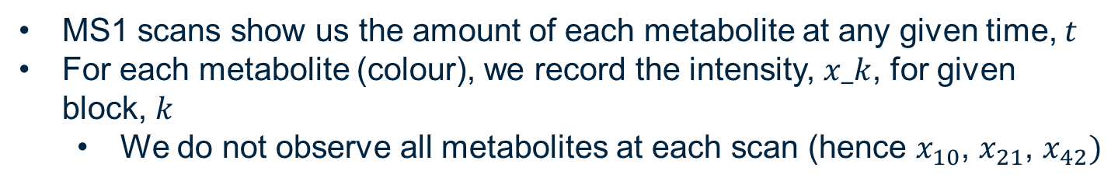
MS1 Scans
MS1 scans show us the amount of each metabolite at any given time, $t$
For each metabolite (colour), we record the intensity, $x_k$, for given block, $k$
We do not observe all metabolites at each scan (hence $x_{10}$, $x_{21}$, $x_{42})$
$$x_{10}$$
$$x_{21}$$
$$x_{42}$$
Intensity
m/z

Slide 13





MS2 Scans
MS2 scans allow us to break down the metabolites, so that we can identify them – this can be done for single metabolites (DDA)
$$x_{10}$$
$$x_{21}$$
$$x_{42}$$
Intensity
Intensity
m/z
m/z

Slide 14
MS2 Scans
This becomes more difficult in our experiments
$$x_{10}$$
$$x_{21}$$
$$x_{42}$$
Intensity
Intensity
m/z
m/z

Slide 15
MS2 Scans
This becomes more difficult in our experiments
What we actually see (no colours)
$$x_{10}$$
$$x_{21}$$
$$x_{42}$$
Intensity
Intensity
m/z
m/z

Slide 16
Our Aim
Intensity
m/z
Intensity
Intensity
Intensity
m/z
m/z
m/z

Slide 17
Statistical Analysis
Metabolomics Workflow
Sample + Sample Preparation
Data Collection
Data Processing
Metabolite Identification
Molecular Networking

Slide 18

Thanks for Listening
Let me know if you have any questions
Or feel free to reach out at: Vinny.Davies@Glasgow.ac.uk
Slides available at:
https://github.com/vinnydavies/presentations

